Slide 1
DA105.B (Wednesday)
Feel free to add comments. To use the slides, create a copy (file -> make a copy)

Slide 2


DA105 - Data Storytelling
Charts for Social Media Posts
While we're waiting to begin,
please answer in the Zoom chat:
We’re using Tableau today.
Have you set it up yet?

Slide 3

Intro
What we’ll do today
Create 3 visualizations using Tableau that we convey key messages from the awareness campaign
These should be suitable to post on social media to a broad audience

Slide 4

Today's Agenda
Intro & Setup
10 min
Tableau time!
45 min
Questions & Wrap-up
5 min

Slide 5
Intro

Slide 6


Raise awareness of mental health issues around the world
Mobilize efforts in support of mental health

Slide 7

The campaign’s key messages
Source: World Health Organization
Close to one billion people have a mental disorder.
On average, countries spend just 2% of their national health budgets on mental health.
For every $1 USD invested in treatment for depression & anxiety, there is a return of $5 USD.

Slide 8





DA105 Business Case
Week 1
Key Messages & Social Media
Week 2
Marketing Budget Analysis
Week 3
Donor Presentation
Week 3
Dashboard & Infographic
Today’s topic: Visualizations for social media posts

Slide 9

This month you are:
Communications Associate
Marcus Patel
Lives in the outskirts of Dublin, Ireland
His role originally focused on writing feature stories but switched to data journalism
Loves any crossroads of art and science – like data visualization!
Still not over the Game of Thrones series finale

Slide 10


Meet your coworker:
Social Media Coordinator
Jasmine Carter
Washington, D.C., USA
Has a strong intuition for what messages will “stick” with audience
Loves painting, and makes the most out of her National Gallery of Art museum membership
Can do a perfect Spongebob Squarepants* laugh (it’s eerily spot-on)
* it’s a children’s cartoon

Slide 11
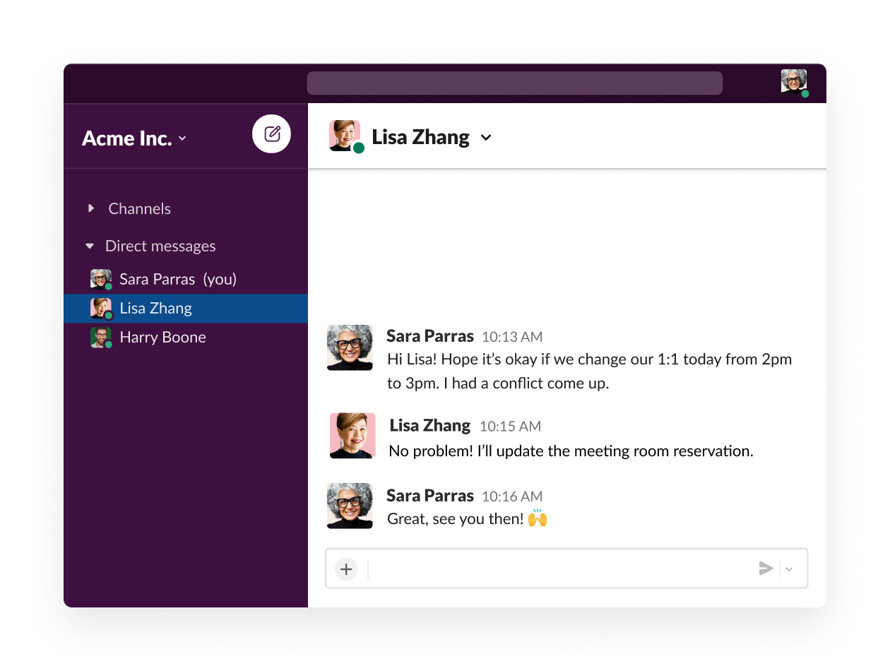


Business Question
Creating visualizations for social media
Focusing on a broad audience
WHO Internal
Jasmine Carter
There are some key things to keep in mind about this audience.
People on social media are bombarded with tons of content, and fast. You only have moments to catch their attention and make your point!
They don’t necessarily have context on the WHO or mental health. Keep it simple.
Jasmine Carter
Hey Marcus,
It was great chatting with you today. I’m glad we could decide on the 3 key messages we want to feature in the social media posts!
If you could send me a first draft of the visualizations by the end of the week, that would be great. We can do a round of edits together once I have a chance to review them.
We’ll truly be the dream team once you get your Patrick Star impression up to par 😁
Marcus Patel (You)
Jasmine Carter
Emily Rivera

Slide 12
Setup

Slide 13
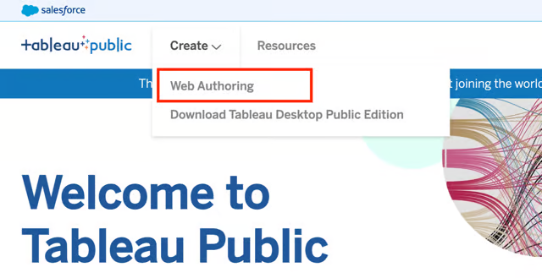
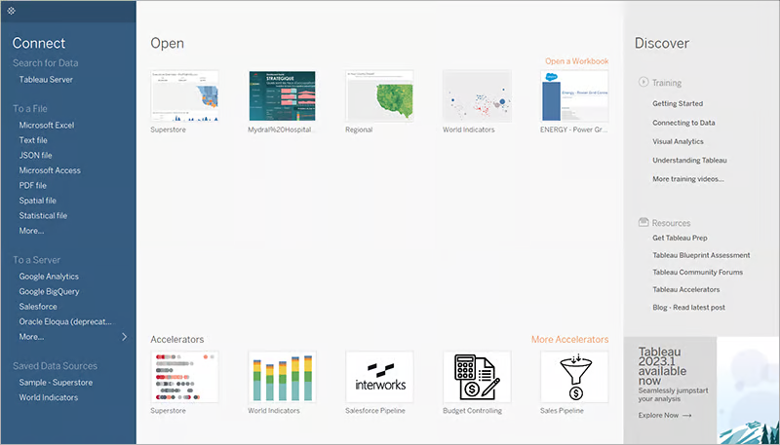
Let’s get set up (links in the chat)
Open Tableau Public
Log in and choose an interface
General guide to Tableau Public
Log in to Tableau Public You should have already created an account.
Two ways to work with Tableau:
Tableau Desktop Public Edition: an application you can download and install on Mac or Windows
Tableau Web Authoring: a more limited browser-based interface

Slide 14
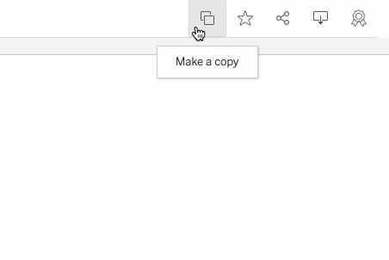
Let’s get set up (links in the chat)
Make a copy of the starter Tableau workbook
How to copy a workbook
Open the link to the workbook and see the icons in the upper right corner:
If you installed Tableau Desktop Public Edition, click Download, then open the file
If you did not install, click Make a copy to use web authoring

Slide 15
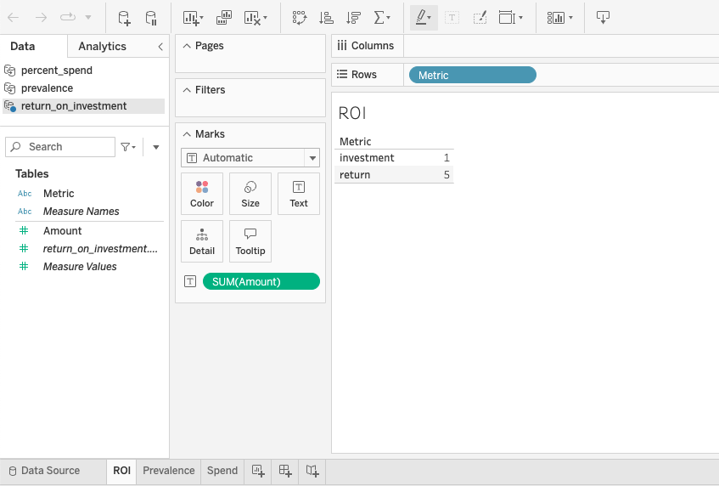
Let’s get set up (links in the chat)
Make a copy of the starter Tableau workbook
Open the workbook
You should have a workbook with 3 data sources and 3 tabs related to each key message:
Prevalence
Spend
Return on investment (ROI)
For each key message, we will start with the visualization provided and improve it!

Slide 16
What questions do you have?
Feel free to raise your emoji hand or type into the chat.

Slide 17
Tableau time!

Slide 18
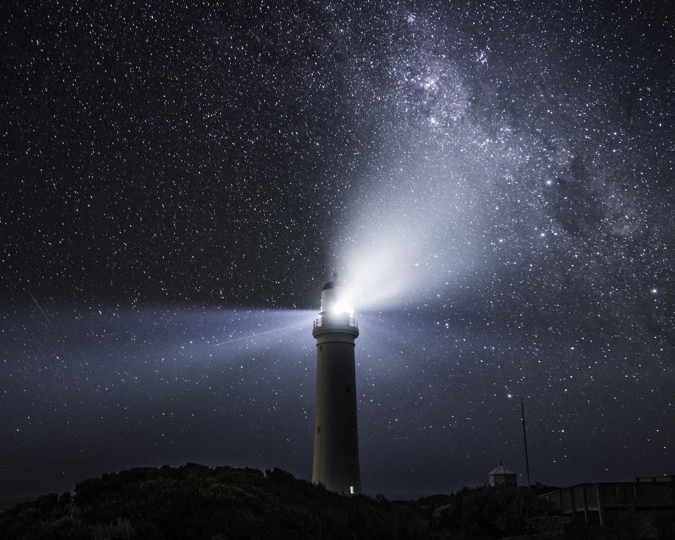
Improving our charts
Key principles for today
Aim for simplicity → Can someone understand this in 5 seconds or less?
Make sure text is readable → Could someone read this on a small screen (smartphone)?
Reduce clutter and add visual appeal → Would this catch someone’s attention while scrolling?

Slide 19
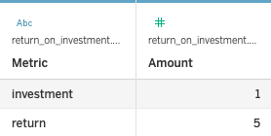
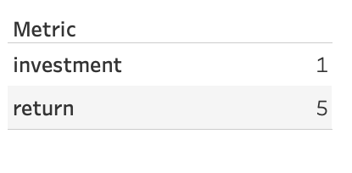
Let’s start with the first key message:
For every $1 USD invested in treatment for depression & anxiety, there is a return of $5 USD.
Data Source
Visualization

Slide 20
Raise your emoji hand to speak or type in the Zoom chat
For every $1 USD invested in treatment for depression & anxiety, there is a return of $5 USD.
What do we want to emphasize?
Does this visualization emphasize that point?
Does this visualization use optimal visual encodings?
What changes should we make?
Visualization

Slide 21
For every $1 USD invested in treatment for depression & anxiety, there is a return of $5 USD.
What do we want to emphasize? → A high return on investment 👍
Does this visualization emphasize that point? → No, the difference between 1 and 5 doesn’t stand out
Does this visualization use optimal visual encodings? → No, we aren’t using any
What changes should we make? → Let’s do it together!
Visualization

Slide 22
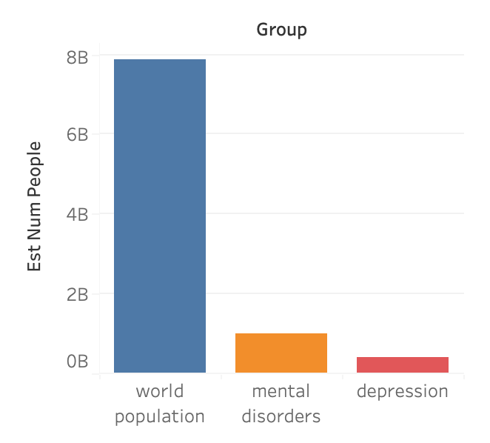
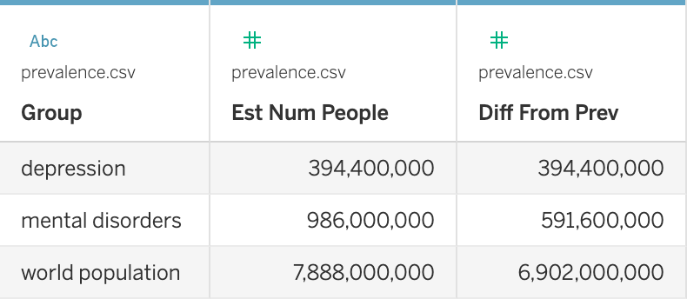
Moving on to the second key message:
Close to one billion people have a mental disorder.
Visualization
Data Source

Slide 23
Raise your emoji hand to speak or type in the Zoom chat
Close to one billion people have a mental disorder.
Visualization
What do we want to emphasize?
Does this visualization emphasize that point?
Does this visualization use optimal visual encodings?
What changes should we make?

Slide 24
Close to one billion people have a mental disorder.
Visualization
What do we want to emphasize? → Mental disorders are common
Does this visualization emphasize that point? → No, it looks small compared to the world population
Does this visualization use optimal visual encodings? → Yes, length is high on the perceptual hierarchy
What changes should we make? → Let’s do it together!

Slide 25
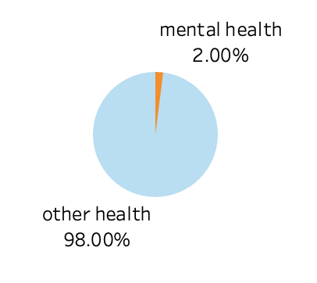
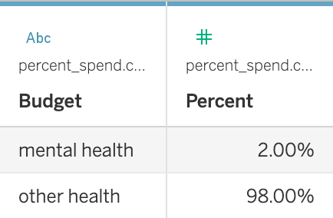
Let’s finish up with our third key message:
On average, countries spend just 2% of their national health budgets on mental health.
Visualization
Data Source

Slide 26
Raise your emoji hand to speak or type in the Zoom chat
On average, countries spend just 2% of their national health budgets on mental health.
Visualization
What do we want to emphasize?
Does this visualization emphasize that point?
Does this visualization use optimal visual encodings?
What changes should we make?

Slide 27
On average, countries spend just 2% of their national health budgets on mental health.
Visualization
What do we want to emphasize? → 2% is a small percentage
Does this visualization emphasize that point? → Yes, it’s a very small slice of the pie
Does this visualization use optimal visual encodings? → No, angle should usually be replaced by length/position
What changes should we make? → Let’s do it together!

Slide 28
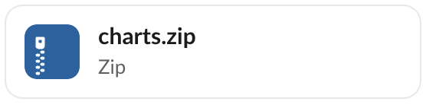
Business Question
Creating visualizations for social media
You made simple, clear, effective visualizations!
WHO Internal
Jasmine Carter
Marcus Patel
The key messages for the campaigns will come through loud and clear with laser-focused visualizations.
Sometimes, the majority of work in a visualization is customizing it to be just right for the task and audience at hand!
Hi Jasmine! Here are the first draft of those visualizations for the social media posts. I would love to hear what you think. 👀
Marcus Patel (You)
Jasmine Carter
Emily Rivera
Jasmine Carter
Wow, Marcus! These will really pop out of people’s feeds.
I have a few minor layout suggestions, and we need to make sure these are consistent with the typography and colors for the campaign. I’ll send you a meeting invitation to go over it later this week.

Slide 29
What questions do you have?
Feel free to raise your emoji hand or type into the chat.

Slide 30

Wrap-up
Campus material is live and available 24/7.
Use Chat Bubble as much as you need!
Reach out w/ questions via Slack.
Next live session on Monday

Slide 31
Next up…
Week 1
Key Messages & Social Media
Week 2
Marketing Budget Analysis
Week 3
Donor Presentation
Week 3
Dashboard & Infographic
Monday’s topic: Marketing Budget Analysis (Part I)

Slide 32
Thank You
And Keep Practicing!
Notes:
End of Presentation slide

